Slide 1

ECEN-765 project
Machine Learning Based GPS Outliers Detection Methods
Hongxin Kong
UIN: 325006848

Slide 2
Outline
Introduction and motivation
Methodology
Experiments
Conclusion and Discussion

Slide 3
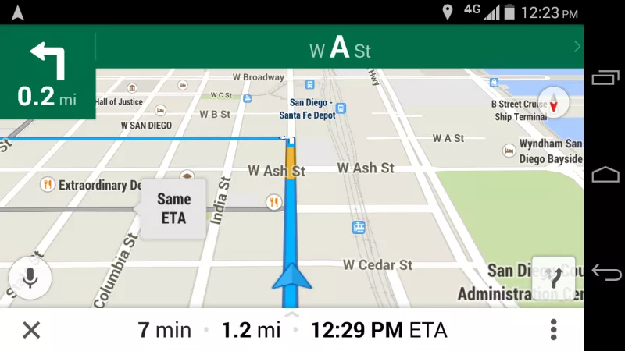
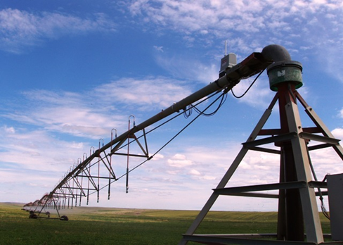

Introduction
GPS has been widely used
Mobile positioning
navigation
Irrigation system

Slide 4

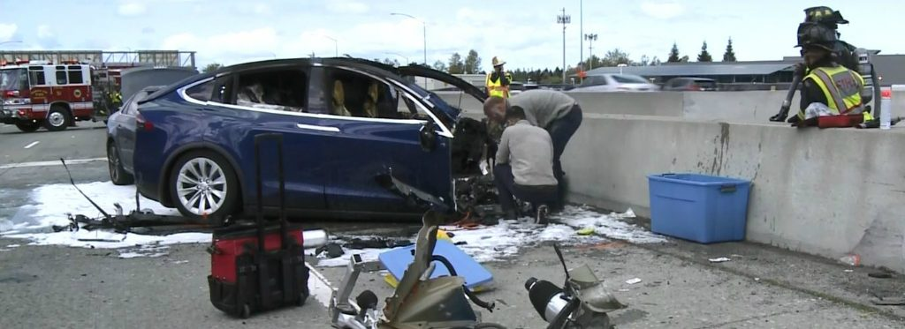
However GPS accuracy is not good enough
Averaging all the data we get
Tall buildings block the GPS signal
Sometimes the error can reach up to 15 meters !

Slide 5
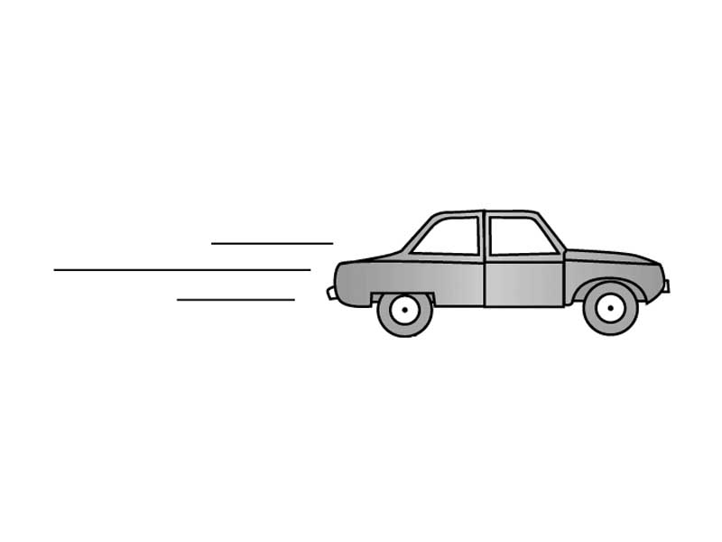
Our goal:
To improve the record of vehicle movement path curved by GPS !

Slide 6

Goal: do classification before averaging
GPS data
bad data
classification
Good data
Candidate set
Only average the data in candidate set
Good GPS data means the distance from GPS to actual location is less than 4 meters

Slide 7
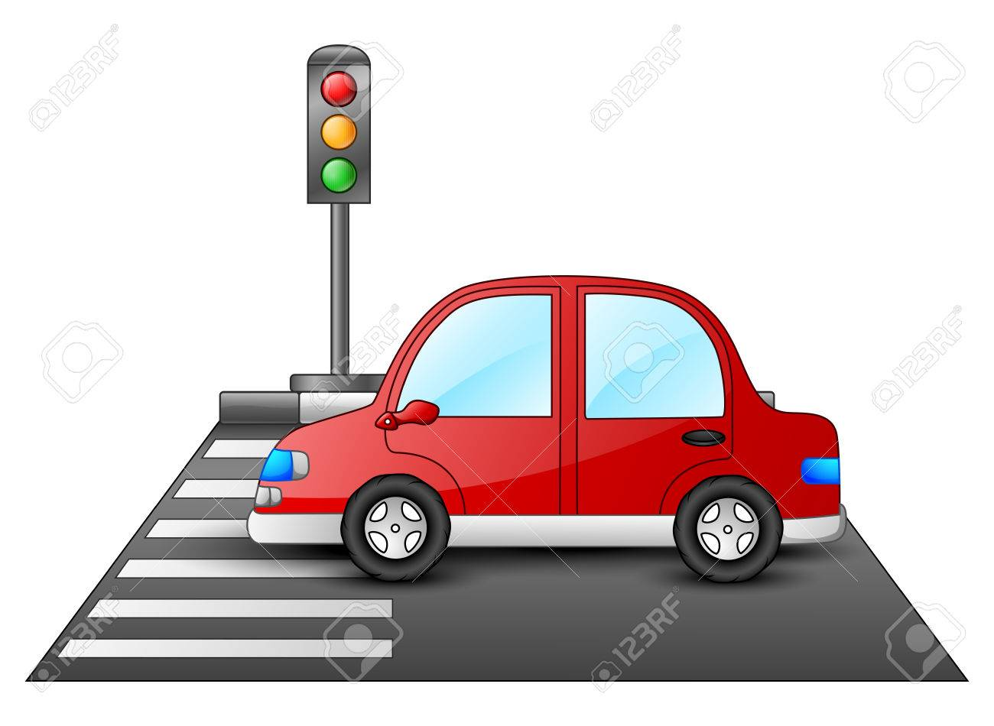
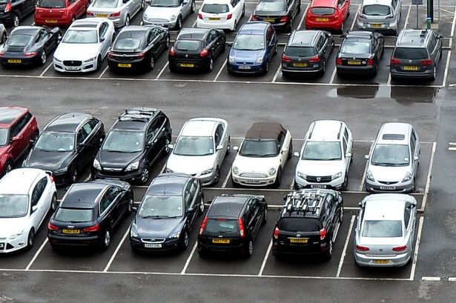
Design
The atmosphere keeps changing when the vehicle moves. The model should be updated quite often. Training data will be collected when the car stops.
The methods we use to train and test the model can not be time-consuming!!

Slide 8
Introduction and motivation
Methodology
Experiments
Conclusion and Discussion

Slide 9
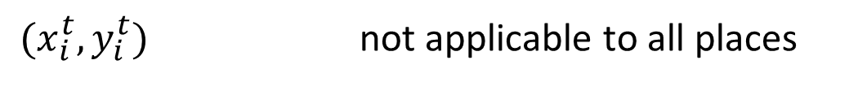

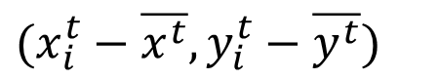
Methodology
Feature selection
For each GPS data at location t, it contains a latitude and a longitude $(x_{i}^{t},y_{i}^{t})$
$(x_{i}^{t},y_{i}^{t})$ not applicable to all places
$$(x_{i}^{t}−\overline{x^{t}},y_{i}^{t}−\overline{y^{t}})$$
Get a low testing accuracy 15.6% in linear regression
$$(x_{i}^{t}−\overline{x^{t}},y_{i}^{t}−\overline{y^{t}},x_{i}^{t}−\overline{x^{t−1}},y_{i}^{t}−\overline{y^{t−1}},x_{i}^{t}−\overline{x^{t−2}},y_{i}^{t}−\overline{y^{t−2}})$$
Low rank level for the feature matrix
Finally, apply the square form$\left({（x}_{i}^{t}−\overline{x^{t}}）^{2}…\right)$as features for each GPS sample

Slide 10
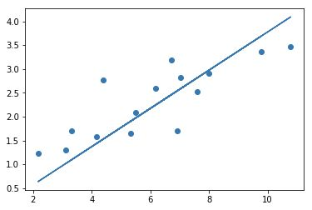
Classification methods
Linear regression
Logistic regression
It can be solved with normal equation and save a lot of time
Widely used , easy to update with gradient descent

Slide 11
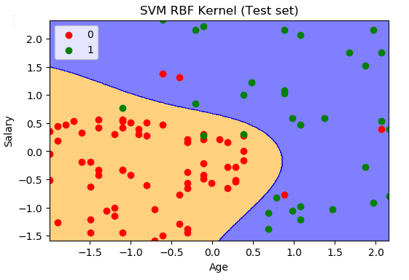
Linear kernel SVM
BP neural network
The core of deep learning, used to solve complicated problem
Gaussian RBF kernel SVM

Slide 12
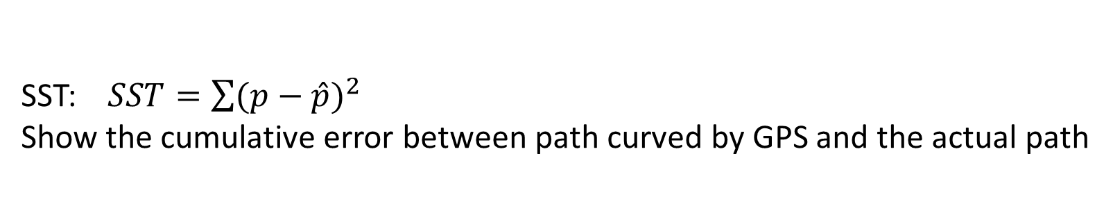
SST value
In order to evaluate the effectiveness of classification methods
GPS curved path
Actual path
SST
SST: $SST=\sum{(p−\hat{p}})^{2}$
Show the cumulative error between path curved by GPS and the actual path

Slide 13
Introduction and motivation
Methodology
Experiments
Conclusion and Discussion

Slide 14
Experiments
Each point records 3000 GPS data.
6000 data is treated as training data.
9000 data is treated as testing data.

Slide 15
Linear regression
Normal equation is used to calculate the parameter for linear regression:
Training accuracy: 77.53%
Testing accuracy:51.56%

Slide 16
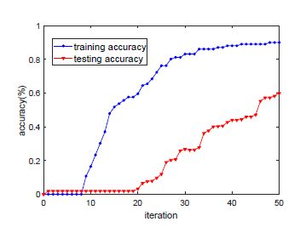
Logistic regression
Gradient descent is used to calculate the parameter for logistic regression, the relationship between accuracy and iteration is shown in the figure:
At 50 literation
Training accuracy: 89.02%
Testing accuracy:59.8%

Slide 17
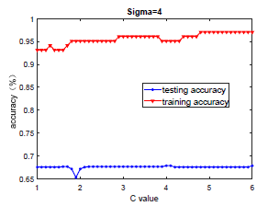
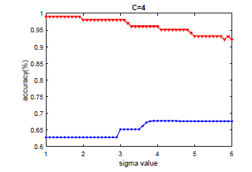
SVM
Linear kernel
Training accuracy: 94.12%
Testing accuracy:60.19%
the relationship between accuracy and value of two parameters is shown in the figure
RBF
Sigma=4 and C=4 obtains
Training accuracy:97.06%
Testing accuracy:63.65%

Slide 18
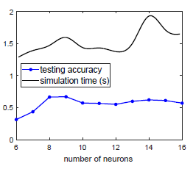
BP neural network
One hidden layer with 9 neurons
Get training accuracy : 100%
Testing accuracy: 66.911%
Time:1.691s
Two hidden layers:
Testing accuracy:66.411%
Time:1.884s.
Three hidden layers,
testing accuracy :75.944%
the simulation time:2.269s.
the relationship between accuracy ,simulation time and number of neurons is shown in the figure. Simulation time around 1.5s and accuracy around 60%

Slide 19
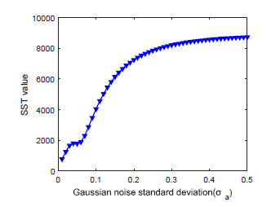
Kalman Filter

Slide 20
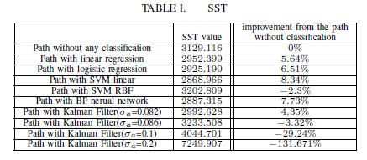
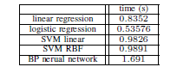
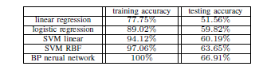
SST and simulation time
1.Logistic regression is the most time-efficient method, better than linear regression on all aspects.
2.BP neural network has highest accuracy but cost a lot of time.
3.Linear SVM is better on SST and less time than neural network.
4. SVM RBF classified all data at 6th point as bad data.

Slide 21
Introduction and motivation
Methodology
Experiments
Conclusion and Discussion

Slide 22
1.Classification methods can help reduce the error caused by averaging all original GPS
2. Logistic regression and linear SVM may be used together
3.More test should be implemented and more methods like Kalman filter can be combined.

Slide 23
Thank you!

